Slide 1
Tutorial 1
Getting Started with Excel

Slide 2
Objectives
Understand the use of spreadsheets and Excel
Learn the parts of the Excel window
Scroll through a worksheet and navigate between worksheets
Create and save a workbook file
Enter, analyze, and present quantitative data
Enter text, numbers, and dates into a worksheet
New Perspectives on Microsoft Office Excel 2007
2

Slide 3
Objectives
Resize, insert, and remove columns and rows
Select and move cell ranges
Insert formulas and functions
Insert, delete, move, and rename worksheets
Work with editing tools
Format data using patterned text and flash fill
Insert and format custom borders
Preview and print a workbook
New Perspectives on Microsoft Office Excel 2007
3

Slide 4
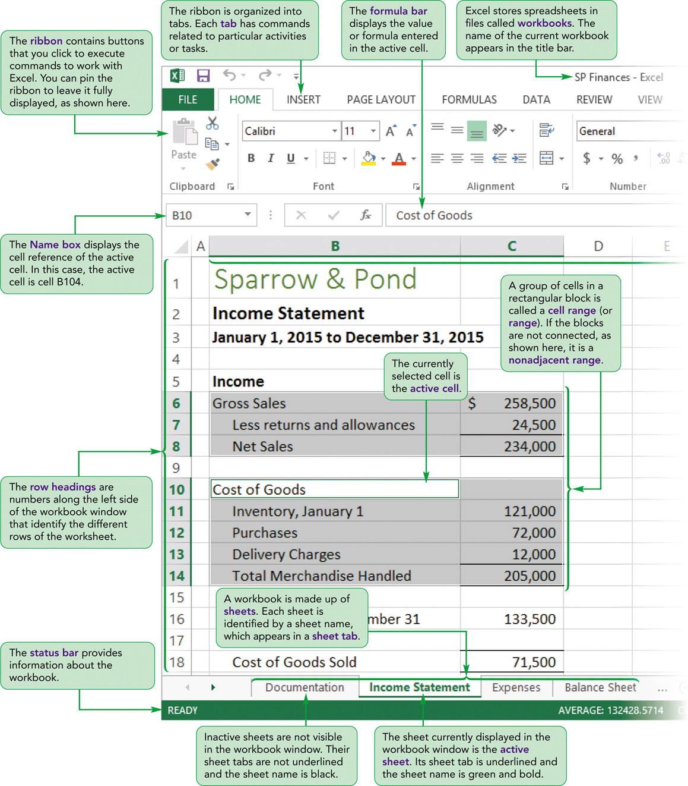
Visual Overview

Slide 5
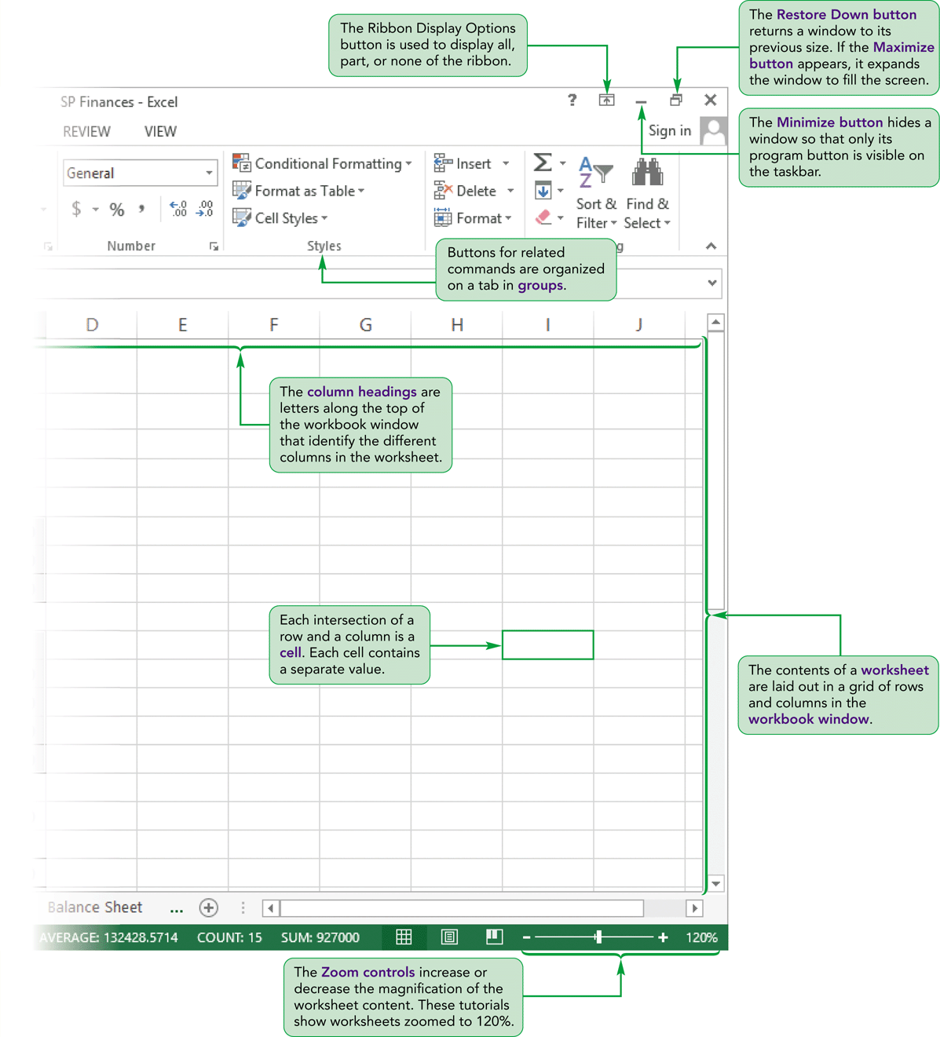
The Excel Window

Slide 6
Introducing Microsoft Excel 2013
Computer program used to enter, store, analyze, and present quantitative data in an organized and easily updatable manner
Creates electronic versions of spreadsheets
  Collection of text and numbers laid out in a grid
Displays values calculated from data
Represents data in both text and graphical from through the use of charts

Slide 7
Microsoft Excel 2013 (Continued)
Allows what-if analysis
  Ability to change values in a spreadsheet and assess the effect they have on calculated values automatically
Automates many tasks through the use of formulas including both automatic formulas and custom formulas
A Quick Analysis tool allowing conversion from data to charts in two easy steps

Slide 8
Microsoft Excel 2013 (Continued)
Integrates data from several spreadsheets within a single workbook, and also interfaces with other workbooks when data from multiple sources is required
Templates already available for budgets, calendars, forms, and reports
A new Flash Fill feature allows you to have data automatically entered based on initial data you enter

Slide 9
Microsoft Excel 2013 (Continued)
Excel 2013 offers a Chart Recommendation feature suggesting the best chart to fit your data needs
Excel also increased filtering functionality adding an interactive way to easily filter data in query tables and Excel data tables
Excel 2013 adds a One Workbook, One Table feature allowing you to view multiple workbooks simultaneously

Slide 10
Microsoft Excel 2013 (Continued)
Excel 2013 includes additional functions in several areas including basic math, trigonometry, statistics, look-up, and text functions
New chart features include additions to the chart ribbon, richer data labeling, and adds animation

Slide 11
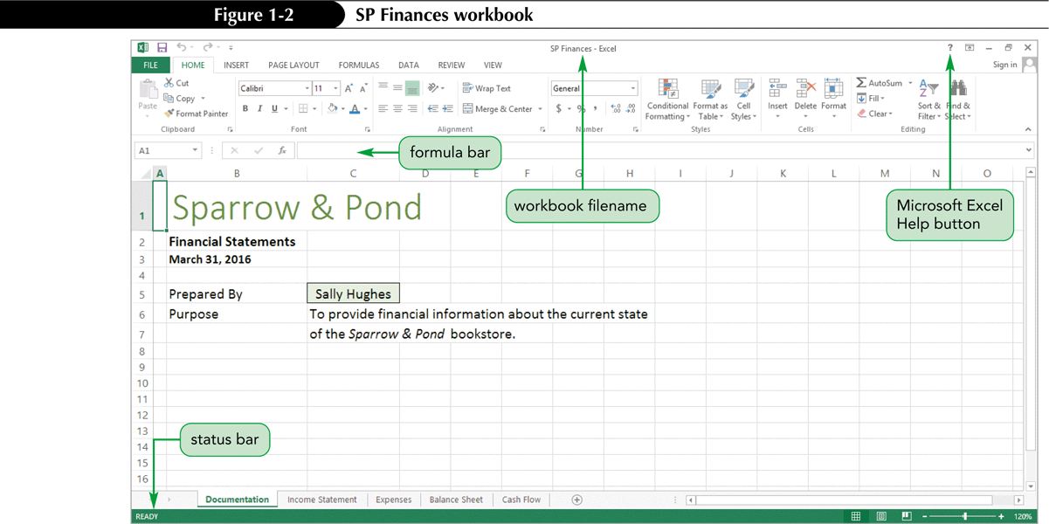
Spreadsheet Data in Excel

Slide 12
Worksheet Navigation
A workbook can have two kinds of sheets:
  Worksheet contains a grid of rows and columns into which user enters data
  Chart sheet provides visual representation of data
Cell reference identifies column/row location

Slide 13
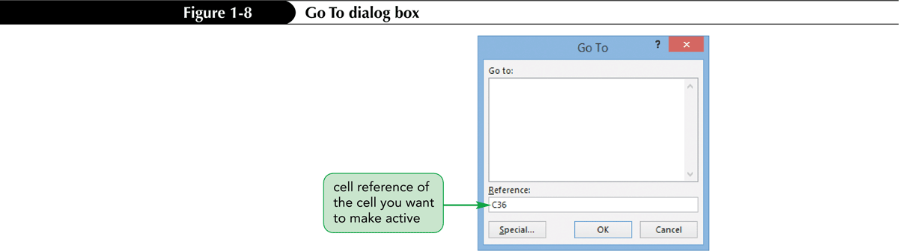
Worksheet Navigation
To navigate between worksheets
  Use sheet tabs
To navigate within a worksheet
  Use mouse, keyboard, GoTo dialog box, or type cell reference in Name box

Slide 14
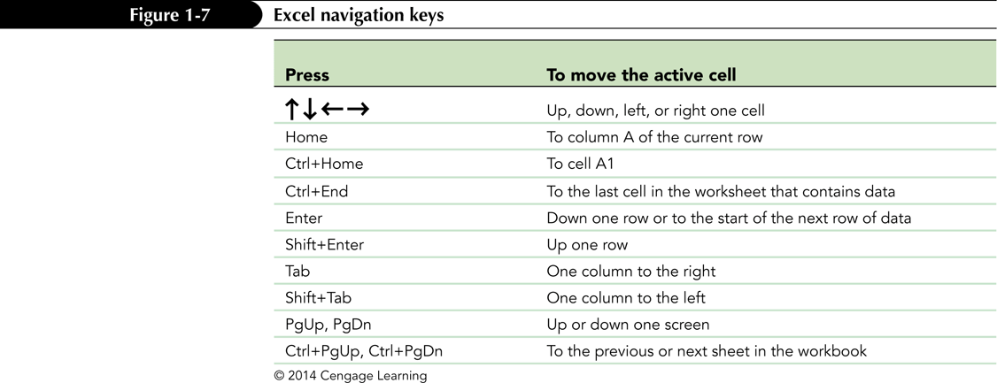
Worksheet Navigation Keys

Slide 15
Planning a Workbook
Use a planning analysis sheet to define:
  Goal or purpose of workbook
  Type of data to collect
  Formulas needed to apply to data you collected and entered
  Appearance of workbook content

Slide 16
Creating a New Work Book
You create new workbooks from the New screen in Backstage view from the Blank workbook template
  On the ribbon, click the File tab to display Backstage view.
  Click New in the navigation bar to display the New screen
  Click the Blank workbook tile.

Slide 17
Working with Worksheets
Inserting a worksheet
  Name of new worksheet is based on number and names of other sheets in the workbook
Deleting a worksheet
Renaming a worksheet
  31 characters maximum, including blank spaces
  Width of sheet tab adjusts to length of name

Slide 18
Working with Worksheets
Moving and copying a worksheet
  To move:
    Click and drag
  To copy:
    Ctrl + drag and drop
  Place most important worksheets at beginning of workbook (leftmost sheet tabs), less important worksheets toward end (rightmost tabs)

Slide 19
Entering Text, Numbers, and Dates
Text data
  Combination of letters, numbers, and symbols
  Often referred to as a text string
Number data
  Numerical value to be used in a mathematical calculation
Date and time data
  Commonly recognized formats for date and time values

Slide 20
Entering Text
New data appears in both the active cell and the formula bar
Truncation
AutoComplete feature
To enter multiple lines of text within a cell
  Create a line break with Alt + Enter

Slide 21
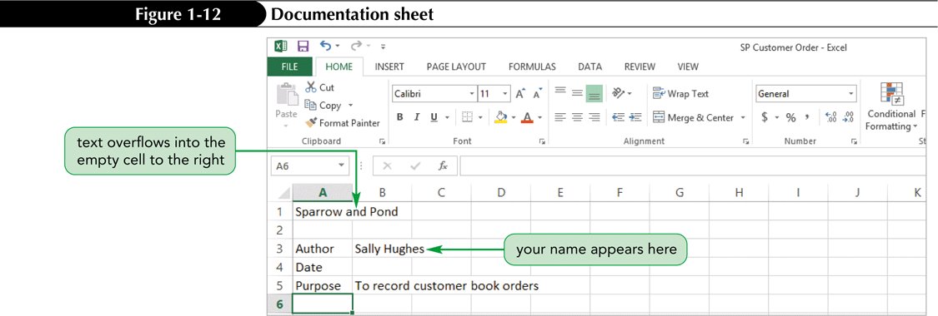
Entering Text

Slide 22
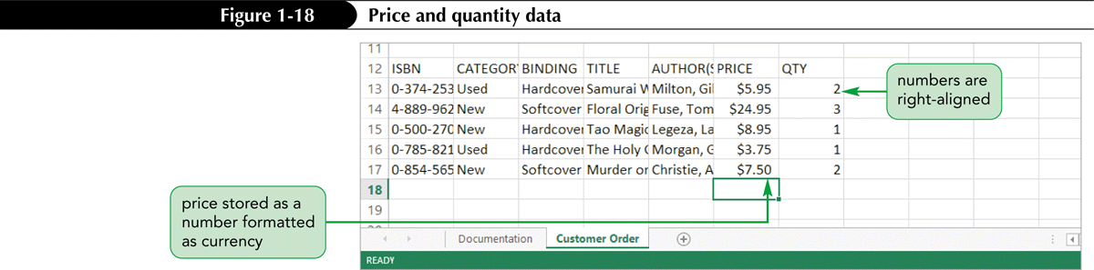
Entering Numbers

Slide 23
Editing Cell Content
As you work, you might find entries you need to change or correct.
  If you want to replace all of the content in a cell, you simply select the cell and then type the new entry to overwrite the previous entry.
  If you need to replace only part of a cell’s content, you can work in Edit mode.

Slide 24
Editing Cell Content in Edit Mode
Edit Mode
  Double-click the cell to select the cell and switch to Edit mode
    A blinking insertion point appears within the text of cell
  Press the arrow keys to move the insertion point to the right of the word being edited
  Press the Backspace key three times to delete the word being edited
  Type & to enter the new text, and then press the Enter key

Slide 25
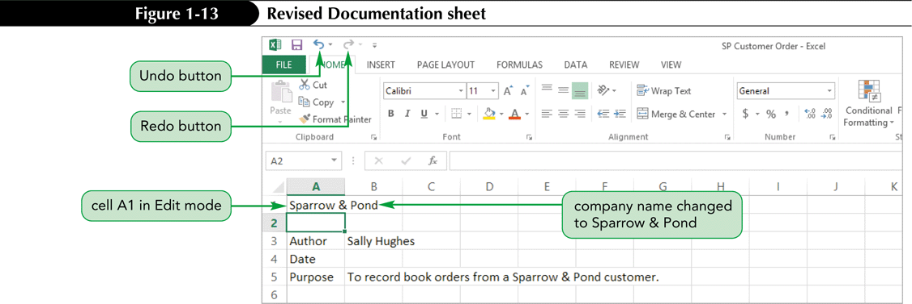
Editing Worksheet Content
Use Edit mode to edit cell contents
  Keyboard shortcuts apply only to text within selected cell
Undoing and redoing an action
  Excel maintains a list of actions performed in a workbook during current session

Slide 26
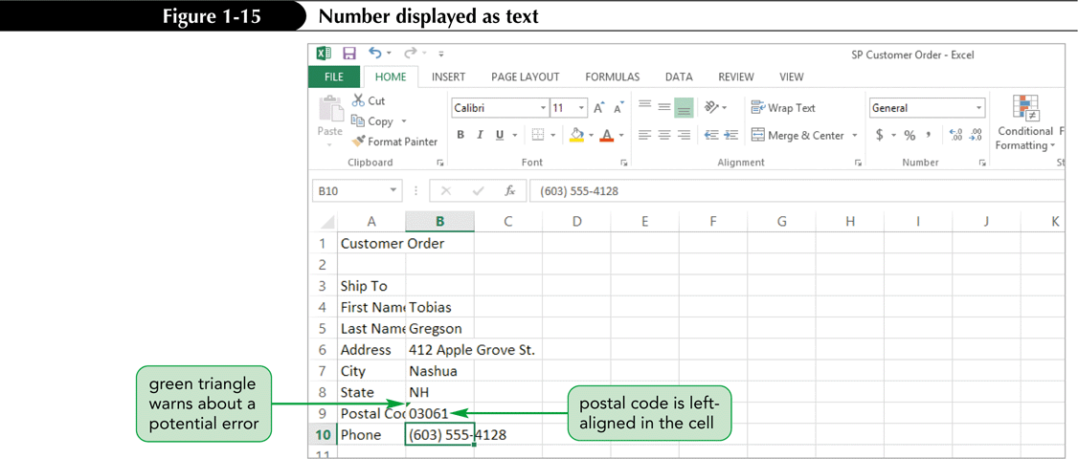
Editing Worksheet Content
Number displayed as text

Slide 27
Entering Numbers

Slide 28
Working with Columns and Rows
To make data easier to read:
  Modify size of columns and rows in a worksheet
To modify size of columns or rows:
  Drag border to resize
  Double-click border to autofit
  Format the Cells group to specify

Slide 29
Working with Columns and Rows
Column width
  Expressed in terms of number of characters or pixels (8.43 characters equals 64 pixels)
  Note: Pixel size is based on screen resolution
Row height
  Measured in points (1/72 of an inch) or pixels
  Default row height: 15 points or 20 pixels

Slide 30
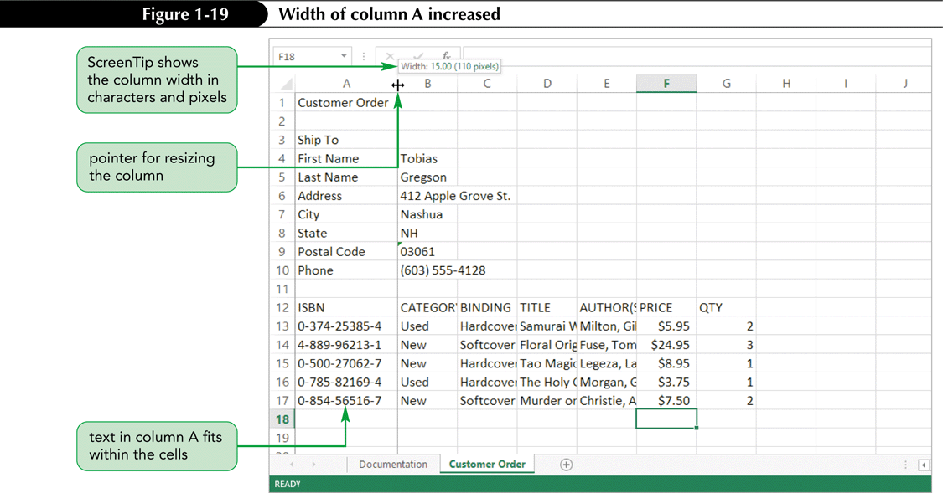
Working with Columns and Rows

Slide 31
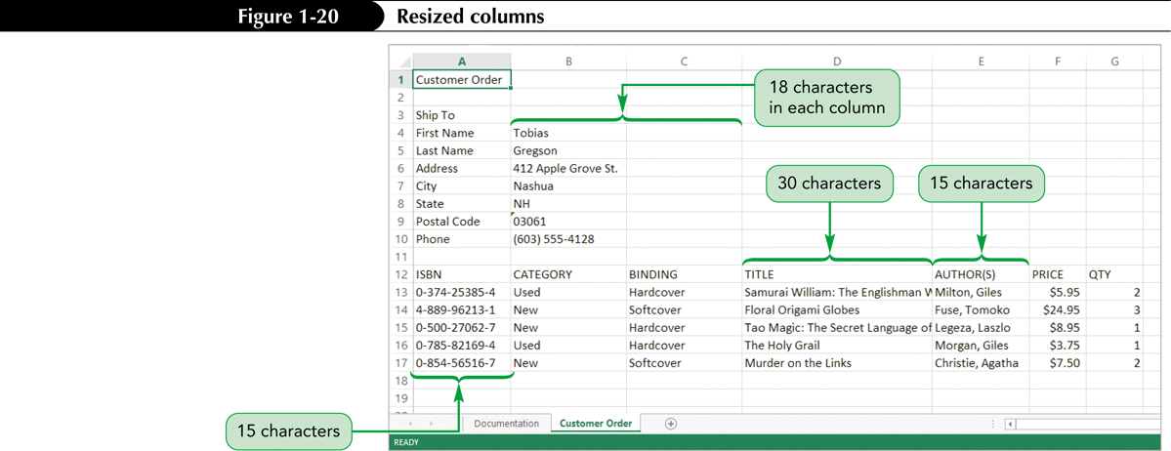
Working with Columns and Rows
Resizing columns and rows with AutoFit

Slide 32
Working with Columns and Rows
Deleting and clearing a row or column
  Deleting removes both the data and the cells
  Clearing removes the data, leaving blank cells where data had been

Slide 33
Wrapping Text Within a Cell
Wrapping text enables text to display on two or more rows within one cell allowing more text within a narrower column.
  Resize the width of column as appropriate.
  Select the cells you wish to apply wrapping to
  On the Home tab, in the Alignment group, click the Wrap Text button.
    The Wrap Text button is toggled on, and text in the selected cells that exceeds the column width wraps to a new line.

Slide 34
Working with Cells and Ranges
Range reference indicates location and size of a cell range
  Adjacent (A1:G5)
  Nonadjacent (A1:A5;F1:G5)
Selecting a range
  Work with all cells in the range as a group
Moving and copying a range
  Drag and drop
  Cut and paste

Slide 35
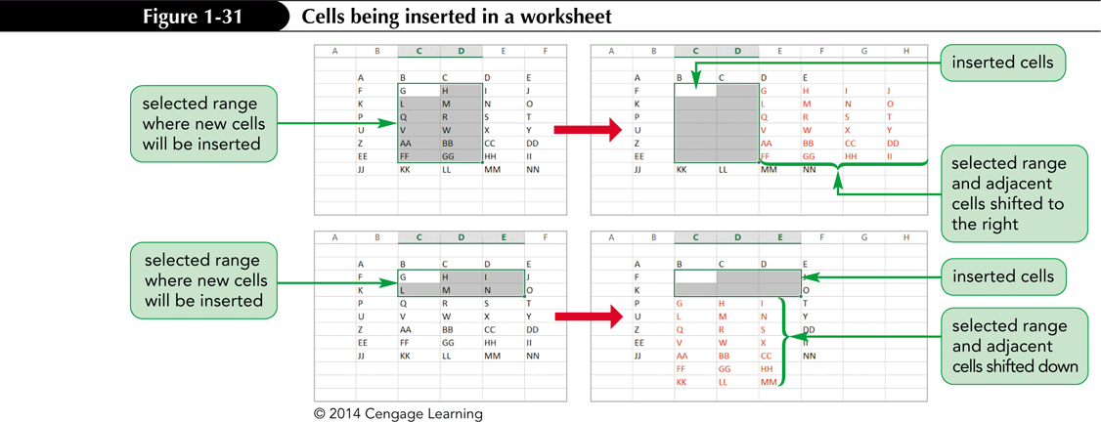
Working with Cells and Ranges
Inserting and deleting a range
  Existing cells shift to accommodate the change

Slide 36
Moving a cell or a Range of Cells
Select the cell or range you want to move or copy
Move the pointer over the border of the selection until the pointer changes shape
To move the range, click the border and drag the selection to a new location
  Or to copy the range, hold down the Ctrl key and drag the selection to a new location

Slide 37
Copying a Cell or Range of Cells
Select the cell or range you want to move or copy
On the Home tab, click the Cut or Copy button
  Or right-click the selection, and then click Cut or Copy on the shortcut menu
Select the cell or the upper-left cell of the range where you want to paste the content
Click the Paste button

Slide 38
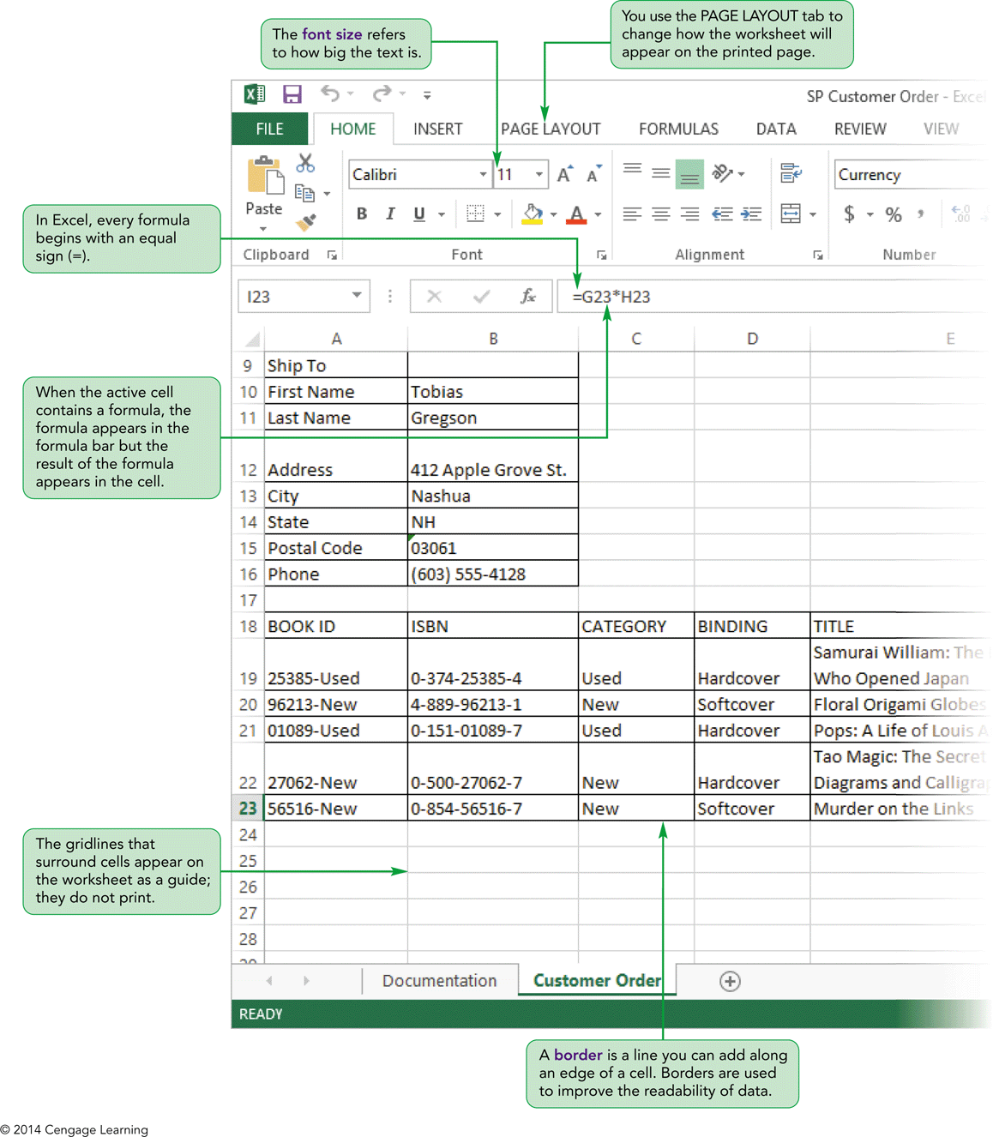
Visual Overview

Slide 39
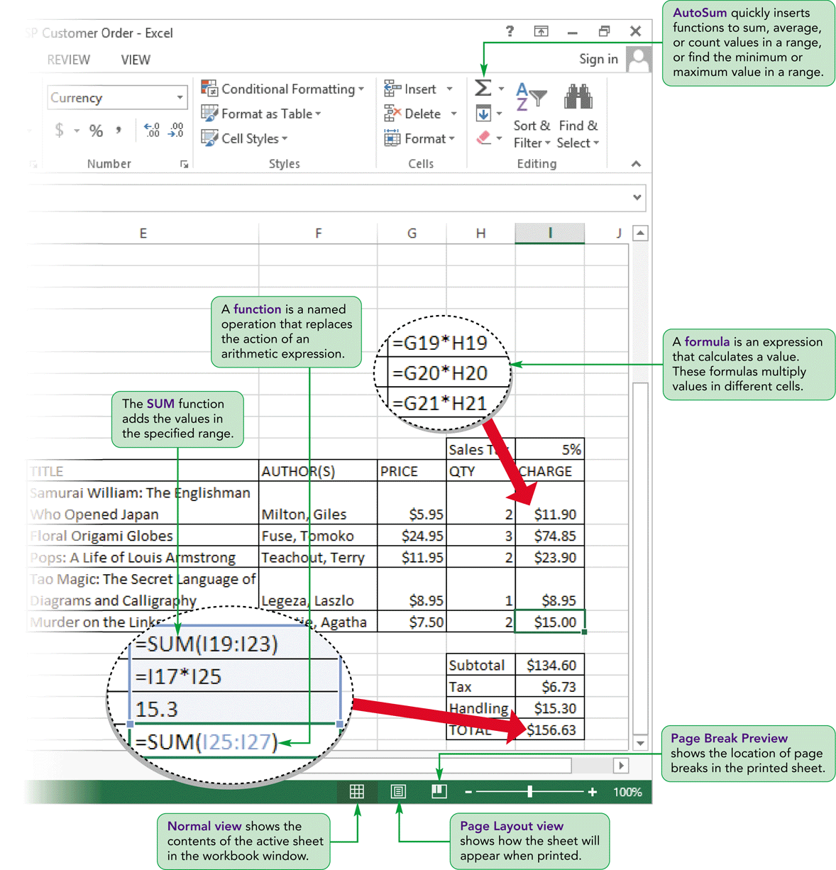
Worksheet Data

Slide 40
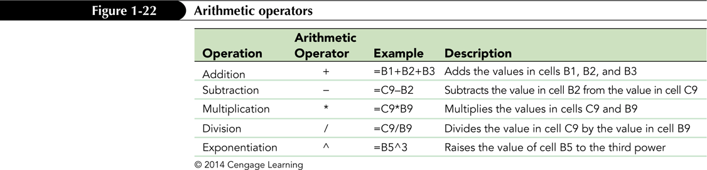
Working with Formulas
Formula
  An expression that returns a value
  Written using operators that combine different values, resulting in a single displayed value

Slide 41
Working with Formulas
Entering a formula
  Click cell where you want formula results to appear
  Type = and an expression that calculates a value using cell references and arithmetic operators
    Cell references allow you to change values used in the calculation without having to modify the formula itself
  Press Enter or Tab to complete the formula

Slide 42
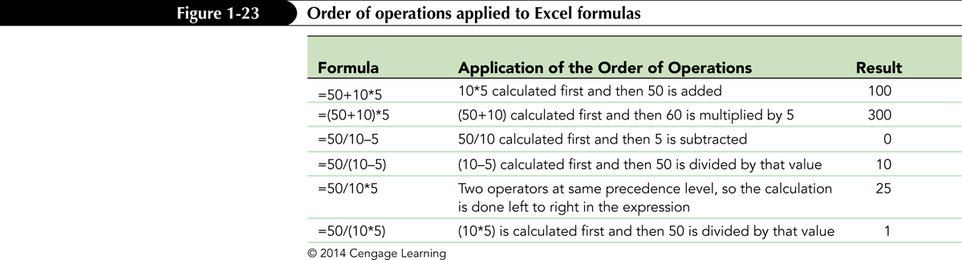
Working with Formulas
Order of precedence
  Set of predefined rules used to determine sequence in which operators are applied in a calculation

Slide 43
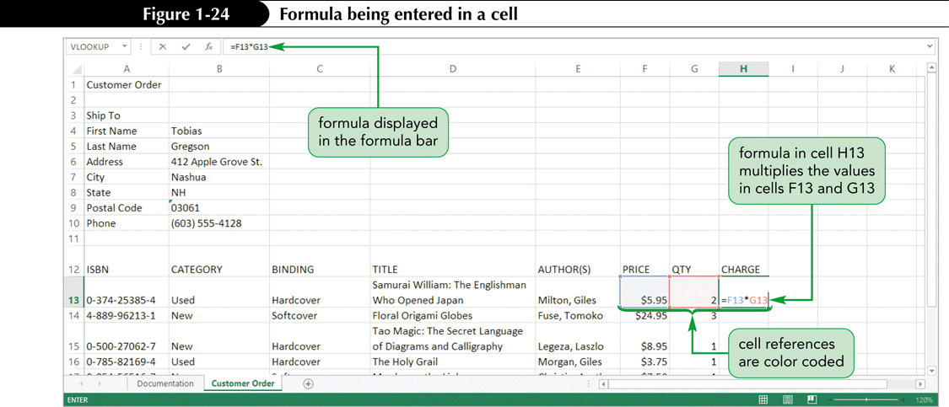
Working with Formulas
Viewing a formula
  Select cell and review expression displayed in the formula bar
  Each cell reference is color coded in the formula and corresponding cell in the worksheet

Slide 44
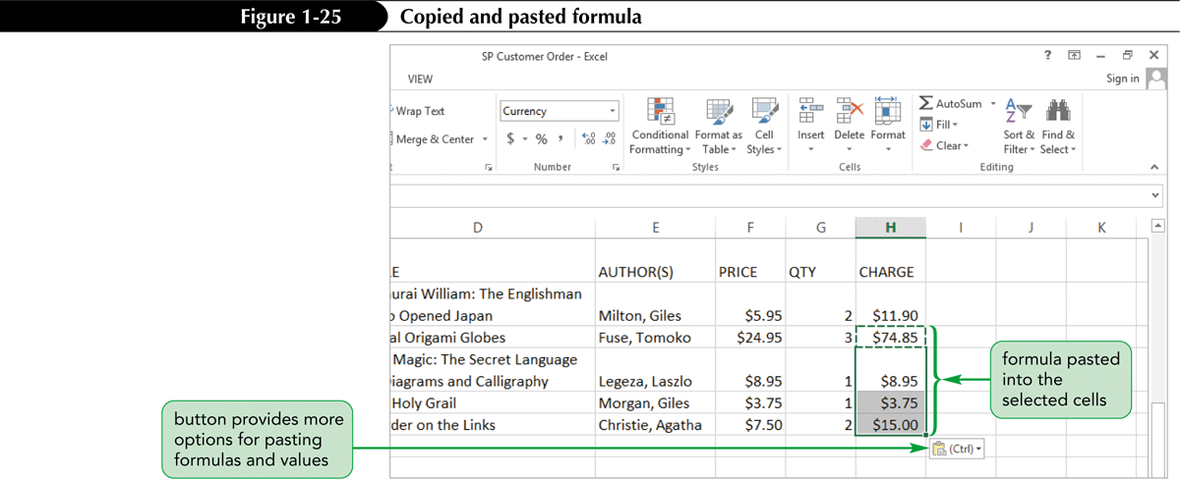
Working with Formulas
Copying and pasting formulas
  Cell references adjust to reflect new location of the formula in the worksheet

Slide 45
Working with Formulas
Guidelines for writing effective formulas:
  Keep them simple
  Do not hide data values within formulas
  Break up formulas to show intermediate results

Slide 46
Introducing Functions
Function
  Named operation that returns a value
  Simplifies a formula, reducing a long formula into a compact statement; for example, to add values in the range A1:A10:
    Enter the long formula:
    =A1+A2+A3+A4+A5+A6+A7+A8+A9+A10
    - or -
    Use the SUM function to accomplish the same thing:
    =SUM(A1:A10)

Slide 47
Entering Functions with AutoSum
Fast, convenient way to enter commonly used functions
Includes buttons to quickly insert/generate:
  Sum of values in column or row (SUM)
  Average value in column or row (AVERAGE)
  Total count of numeric values in column or row (COUNT)
  Minimum value in column or row (MIN)
  Maximum value in column or row (MAX)

Slide 48
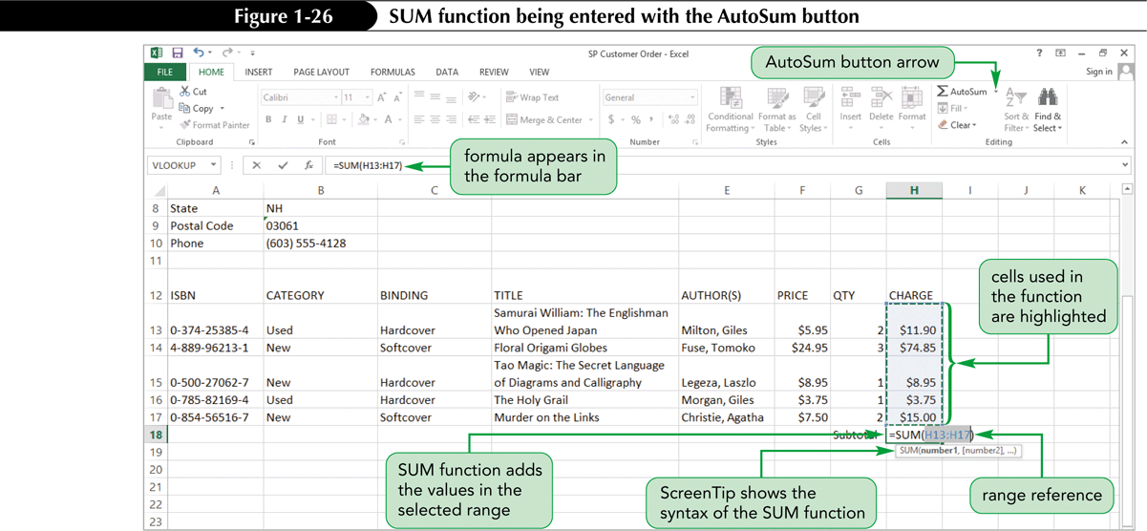
Entering Functions with AutoSum

Slide 49
Previewing a Workbook
Changing worksheet views
  Normal view
  Page Layout view
  Page Break Preview

Slide 50
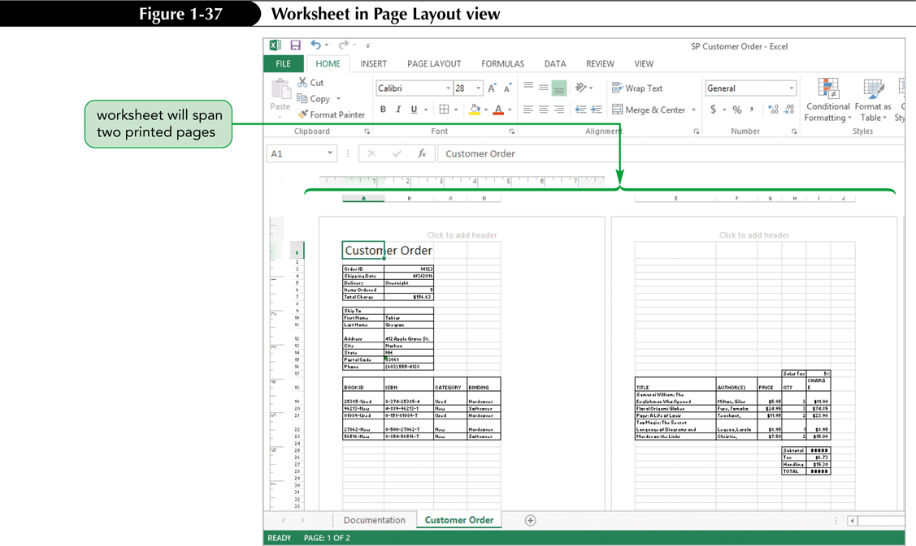
Page Layout View

Slide 51
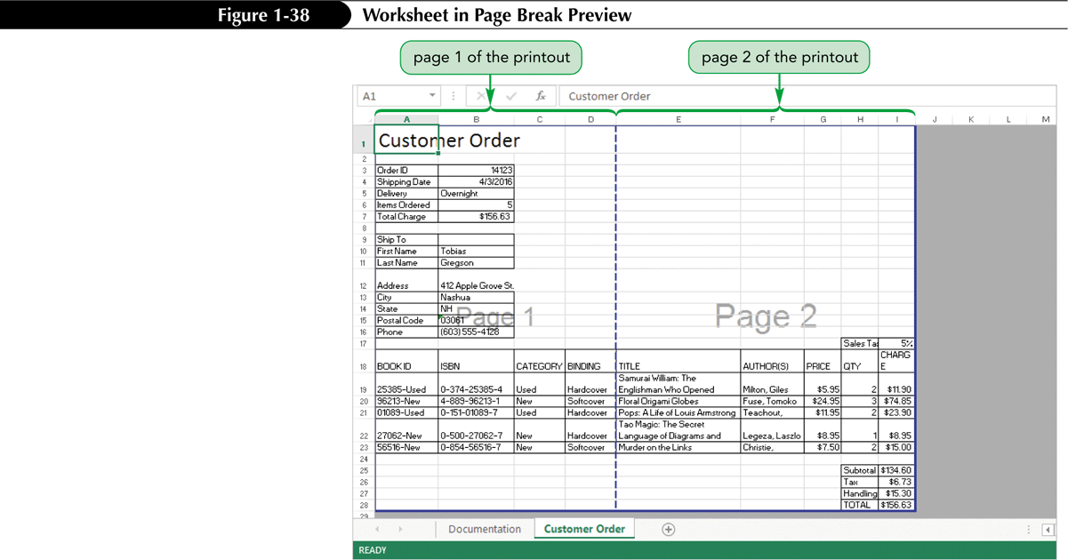
Page Break Preview

Slide 52
Previewing a Workbook
Working with page orientation
  Portrait orientation (default)
    Page is taller than wide
  Landscape orientation
    Page is wider than tall

Slide 53
Printing a Workbook
Print tab provides options for choosing what to print and how to print
  Printout includes only the data in the worksheet
  Other elements (e.g., row/column headings, gridlines) will not print by default
Good practice: Review print preview before printing to ensure that printout looks exactly as you intended and avoid unnecessary reprinting

Slide 54
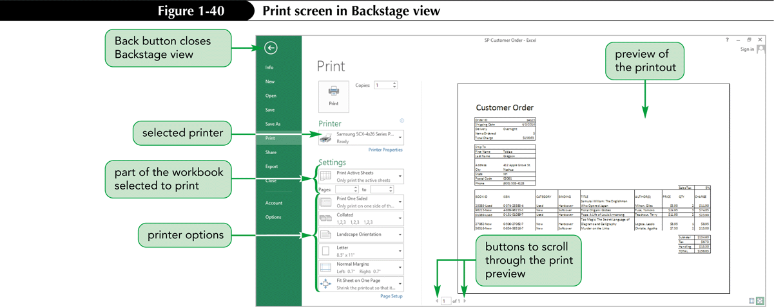
Printing a Workbook

Slide 55
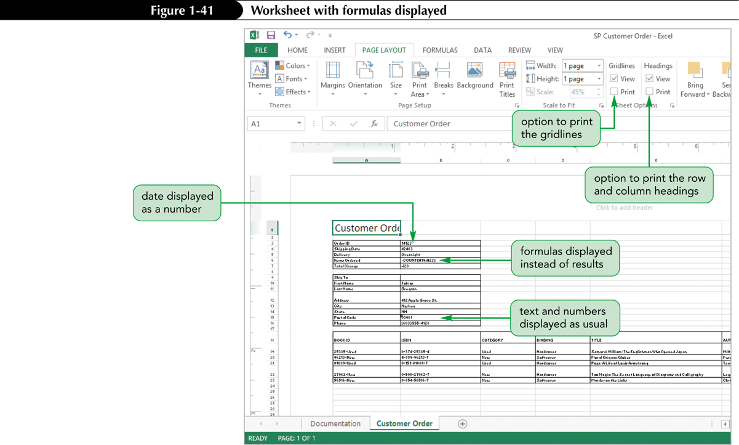
Viewing and Printing Worksheet Formulas
Switch to formula view
  Useful when you encounter unexpected results and want to examine underlying formulas or to discuss your formulas with a colleague

Slide 56
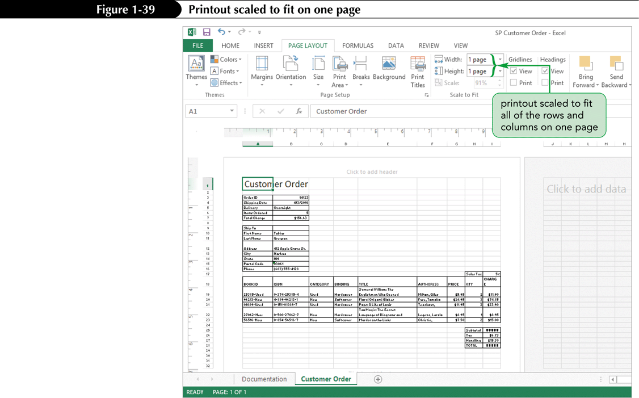
Viewing and Printing Worksheet Formulas
Scaling the printout of a worksheet forces contents to fit on a single page

